Slide 1

<RESEARCH AND DEVELOPMENT ON LASER WELDING OF ALUMINUM 6063 TO ALUMINUM 6063 ON LITHIUM- ION BATTERY>
Enrollment No. Name
AU-1743054 Dhruv Jain
Internal Guide: Dr. Shashi Prakash(Assistant Professor- at Ahmedabad university in SEAS (school of engineering and applied science)
Email id: shashi.prakash@ahduni.edu.in
Supervisor in SLTL: Mayank Patel (DIRECTOR), Mukesk Patel(HR Head), Purv Patel (Design Head) at Sahjanand Laser Technology Ltd. , GIDC at Gandhinagar sector 26.
Email id : purv@sltl.com, mukeshp@sltl.com
BTech Project Presentation (2020-21)
School of Engineering and Applied Science, Ahmedabad University

Slide 2
OUTLINE
Introduction
Problem statement
Methodology
Literature review
Work review
Gantt chart (work plan)
Conclusion
Appendix -I

Slide 3
INTRODUCTION LASER WELDING
When two different types or same type of material is joined together by melting its surface is known as welding. Two types of laser welding a) conduction welding b) keyhole welding.
There are different types of laser beam.
When the laser welding start there are processes to
observe the welding process like:
Melting of metal
Vaporization of material
Plasma production (reflection & absorption)
LASER TYPES
ULTRA VIOLET LASER
CARBON-DI OXIDE LASER
FIBRE LASER
GREEN LASER
SIMPLE FIBRE LASER
PROBABILITY OF DETECTION(POD) LASER

Slide 4
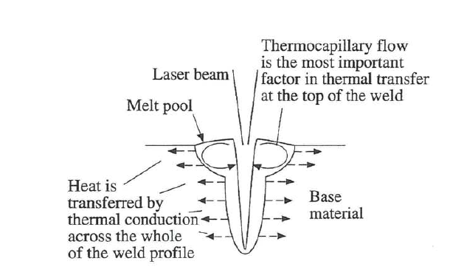
THERMOCAPILLARY FLOW IN KEY HOLE LASER WELDING
The types of thermo capillary flow are:
Surface tension force
Buoyancy force

Slide 5
PROBLEM STATEMENT
Research and development on laser welding of aluminum 6063 to aluminum 6063 on lithium- ion battery
SCOPE OF WORK
The laser weld is the most precise way to weld a material. Due to its enormous energy density, the laser weld process is very fast.
To weld a material with similar metals a machine requires a set of analysis and to create a set of table for different metals we needed to make experimental table manually.

Slide 6
METHODOLOGY
START
Laser welding on lithium-ion battery
Literature review/ book references/ISO standards.
Material gathering & laser welding with sample.
Results & Discussion
Conclusion
Parameter selection and results
Future work
Observation and reduce error.
END

Slide 7

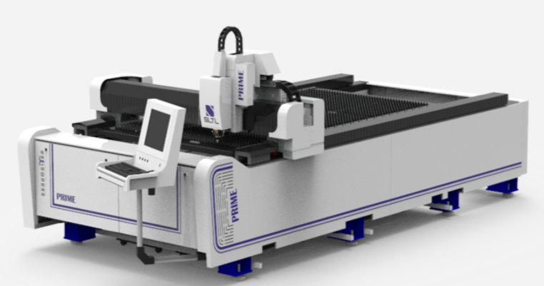
MATERIAL PROPERTIES
Grade-6063-T6 material composition
Spot weld
MACHINE DETAILS
Fibre-laser machine was used with nitrogen/air gas for aluminum alloy welding.
The machine was 3 axis (x, y and z),
The capacity of machine up to 3kw &works on
G & M code.

Slide 8
LITERATURE SURVEY
NO | TITLE | ABSTRACT | AUTHOR | CONCLUSION
1 | Laser welding of aluminum alloy 5083 | laser welding of AL using conduction mode and keyhole method and tensile strenght is compared. | P.Okon, G.Dearden, K.Watkins, M.Sharp, P.French | LCW process shows that the penetration is deep with increase in spot radius and in LKH process laser welding is deeper but speeding of molten metal will be less wider. LCW is stronger In tensile strength than LKH.
2 | Investigation of metal mixing in laser keyhole welding of dissimilar metals. | To investigate the underlying physics of the welding process, a numerical model is developed to simulate the heat transfer, fluid flow, and metalmixing in the molten pool of dissimilar metals(Al-cu). | Wenkang Huang , HongliangWang , Teresa Rinker ,Wenda Tan | Marangoni force generates one backward flow and two side vortices that facilitate the metal mixing.An increase of laser power increases both the recoil pressure and the Marangoni stress, which drives more copper to migrate upward and mix with aluminum.
3 | Design of welding parameters for laser welding of thin-walled stainless steel tubes using numerical simulation. | The paper is focused on the application of numerical simulation to the design of welding parameters for the circumferential laser welding of thin-walled exhaust pipes from the AISI 304 steel for automotive industry. the influence of welding parameters including the laser velocity from 30 mm.s−1 to 60 mm.s−1 and the laser power from 500 W to 1200 W on the temperature fields and dimensions of fusion zone was investigated using the program code ANSYS. | M Nagy and M Bulova | The laser power from 700 W to 800 W for the welding speed of 30 mm.s−1 and for 900 W to 1100 W welding speed of 50 mm.s−1
4 | Laser Welding and Process Monitoring Applications for Advanced Manufacturing of Batteries and Fuel Cells | Laser welding of similar and dis-similar metals. | Rahul Patwa, H. Herfurth, S. Heinemann, H. Pantsar,B. Regaard,Golam Newaz and Mohammad Hailat | finding parameters according to material and weld quality.
5 | Reduction of porosity content generated during Nd:YAG laser welding of A356 and AA5083 aluminum alloys | The porosity content in laser beads was extensively studied, with the use of different experimental method (X-ray radiography + image analysis, tomography), in order to check the influence of mechanical surface preparation as well as process parameters (single or dual spot, different welding speeds). It was concluded that surface preparation as well as dual beam welding are adequate methods for reducing porosity formation tendency in laser assemblies. | A. Haboudou, P. Peyre, A.B. Vannes, G. Peix. | A surface preparation, especially laser cleaning, reduces the hydrogen sources responsible for microporosity generation, and produces a nearly total suppression of pores in A356. A DSW stabilizes weld pools and key-hole dynamics (fast camera analysis), and reduces to less than 2% the porosity rate, even in 5083 with a severe evaporation of Mg that provokes occluded gases during welding

Slide 9
NO | TITLE | ABSTRACT | AUTHOR | CONCLUSION
6 | Predictionofweldstrengthandseamwidthforlasertransmissionweldingof thermoplasticusingresponsesurfacemethodology | Making an invetigation in laser cutting machien like: weld speed,power,focal length and more. Using simulation like design-expert-v7, making co-relation table,anova table. | Bappa Acherjee , DiptenMisra , DipankarBose, K.Venkadeshwaran | it can be observed from anova table that speed has stronger effect on lap shear joint.as we increase the stand off distance with increase with weld-seam width.spped increase the velocity is required to increse as we want same depth of penetration in weld area.
7 | Welding — Electron and laser beam welded joints — Guidance on quality levels for imperfections | iso criteria is defined for AL after weld to be moderate,intermediate and stringent. | aluminum and its weldable alloys INTERNATIONAL STANDARD ISO 13919-2 | ------
8 | Laser Beam Welding of AA5052, AA5083, and AA6061 Aluminum Alloys | The first one is based on the addition of filler metal. The other new approach is concerned with autogeneous welding using a backing strip from the same base metal, and this could be applicable in production. Hardness measurements and tensile test of AA6061 alloy welds indicated a remarkable softening of the fusion zone due to dissolution of the strengthening precipitates, and this was recovered by aging treatment after welding. For alloys AA5052 and AA5083, softening of the fusion zone due to the loss of its work-hardened condition was much less in comparison with AA6061 alloy. | Rui Vilar | In comparison with alloys AA5052 and AA5083 as work hardenable materials, AA6061 alloy as aged hardened material has experienced severe deterioration in mechanical properties due to softening in the fusion zone resulting from dissolution of the strengthening precipitates in the weld metal and HAZ. However, such deterioration has been recovered by postweld aging treatment, which has resulted in a significant improvement in the mechanical properties.
9 | Improving Laser Beam Welding Efficiency | Methods of welding process efficiency improvement are analyzed | Mikhail Sokolov, Antti Salminen | There are three basic ways to improve LBW efficiency: by modifying the workpiece through surface preparation; by modifying the process with preheating or by lowering the pressure in the welding zone. Preheating techniques are preferable not only because of the resulting increase in process efficiency, but also because of reduction in the occurrence risk of defects. Vacuum-assisted welding provides significant increase in penetration depth and weld quality.

Slide 10
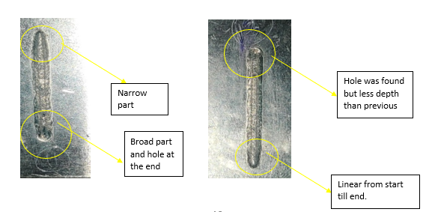
RESULTS ON SAMPLE
Sr No. | Duty cycle (%) | laser power (watt) | Feed speed (mm/min) | Accepted/Rejected | Description
1 | 85 | 3000 | 1100 | Rejected | Penetration was more than required (3 mm)
2 | 85 | 1900 | 1100 | Rejected | Penetration was more than required
3 | 85 | 1800 | 1100 | Rejected | not melted, still last deep hole was found
4 | 85 | 1700 | 1100 | Rejected | weld was not penetrated till back side
5 | 85 | 1600 | 1100 | Accepted | weld was better than previous parameter as at the end hole depth was reduced
 | 100 | 800 | 2500
Duty cycle mean the percentage of actual power provide and used power for laser welding. As we can observe from 1 to 4 a linear pattern was observed but at the 5th row one can observe that there are two laser power with two different speed for better understating lets compare 4th and 5th.As shown the power used for 4th weld was same for 36mm length weld so we found a hole at the end of the weld. This hole is not acceptable so we dived the length with two power supply for first till 32mm we used 1600 wats but for the last 4mm we used 2500 watts to remove that hole depth.

Slide 11
TOP VIEW OF LASER WELDED MATERIAL

Slide 12
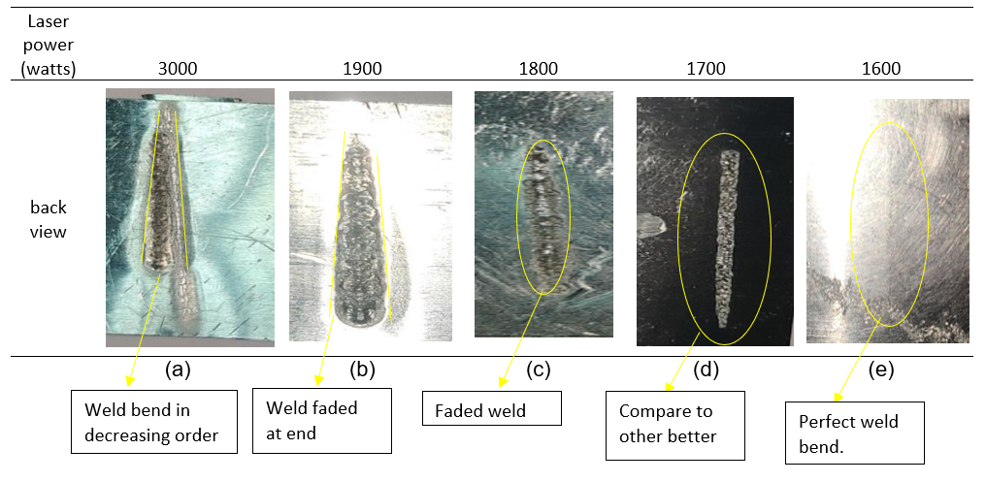
BACK VIEW OF WELDED SAMPLES

Slide 13
DEPTH VS POWER GRAPH BASED ON FEW CONVENTION
As we increase the power the depth penetration in material also increases.
Keeping all other parameters as constant.

Slide 14
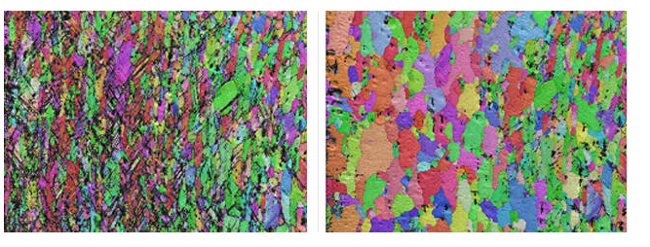
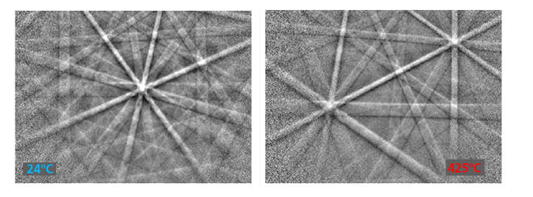
ELECTRON BACKSCATTER DIFFRACTION (EBSD)
An electron backscattered diffraction is a surface analysis technique. a technique to measure the crystalline materials.
The electron backscatter diffraction the microstructure of its main importance to find the grain size structure, identification and grain boundary characteristic it also includes the properties like strength and hardness ductility corrosion electrical conductivity these all are the objectives of the EBSD. The

Slide 15
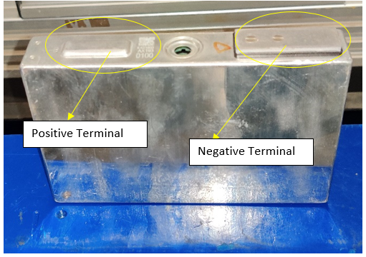
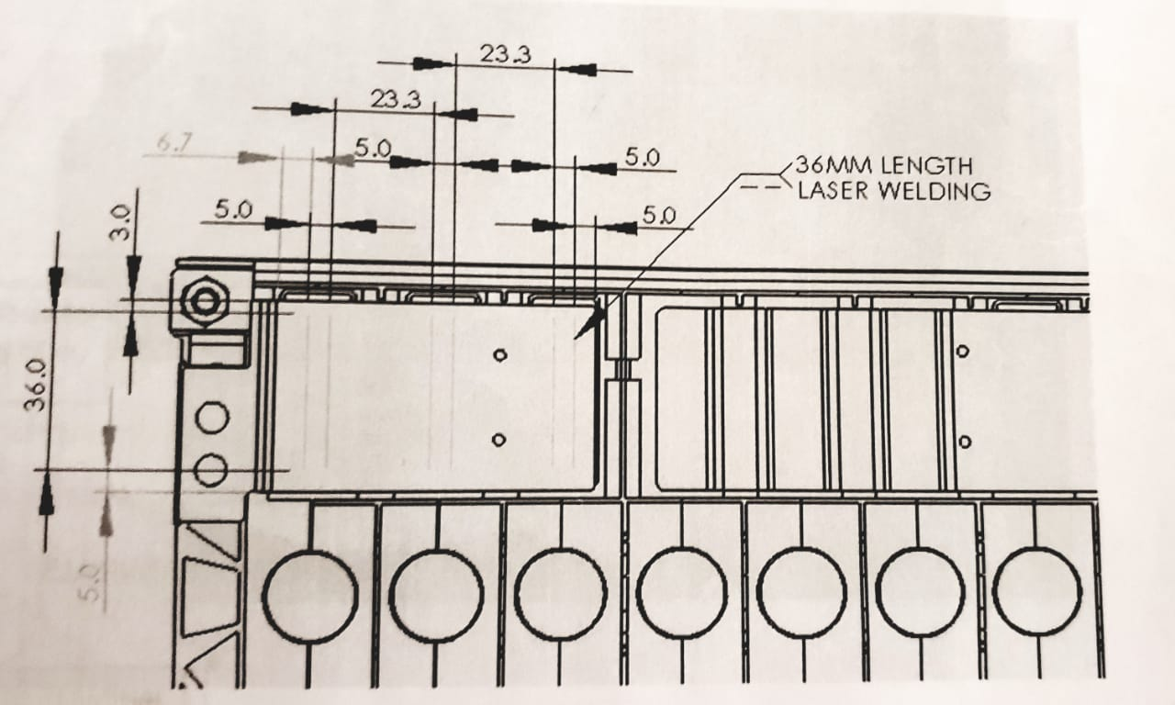
Showing the weld position in 2-d drawing.
One unit of cell displayed in below image on right-side.

Slide 16
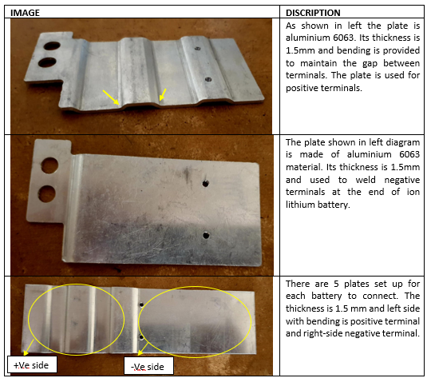
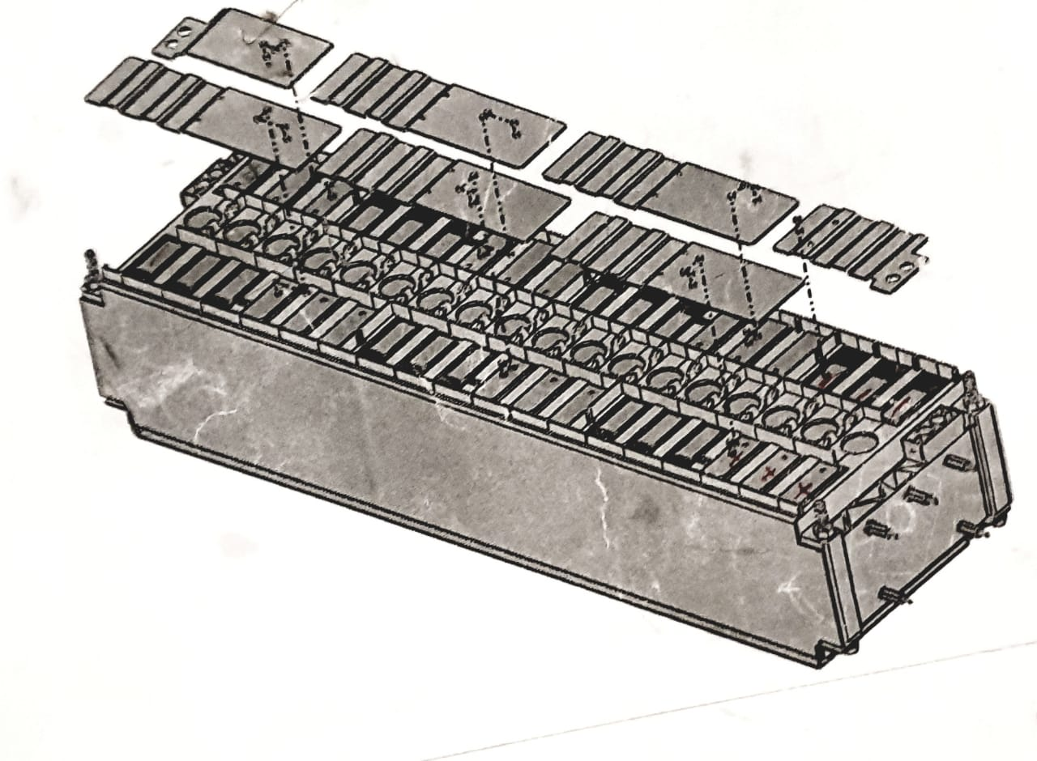
PLATE FOR LASER WELDING WITH LITHIUM-ION BATTERY.

Slide 17
FISHBONE DIAGRAM

Slide 18
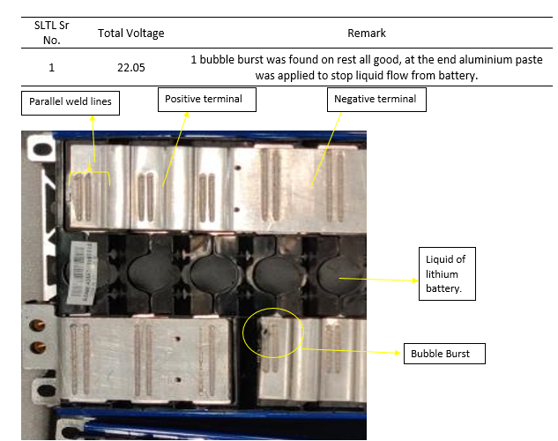
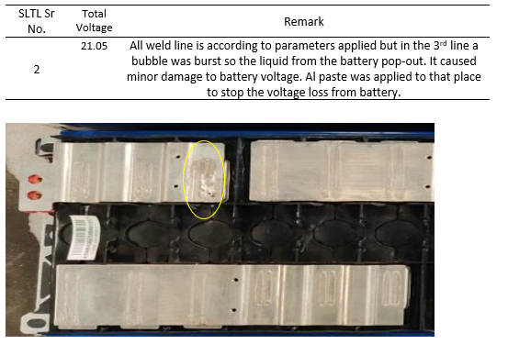
RESULTS OF WELDED ON BATTERY

Slide 19
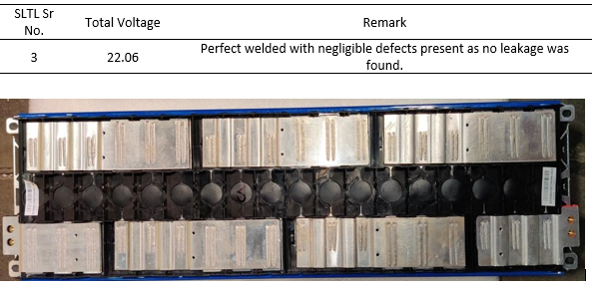
Create a library for welding different types of material together.

Slide 20
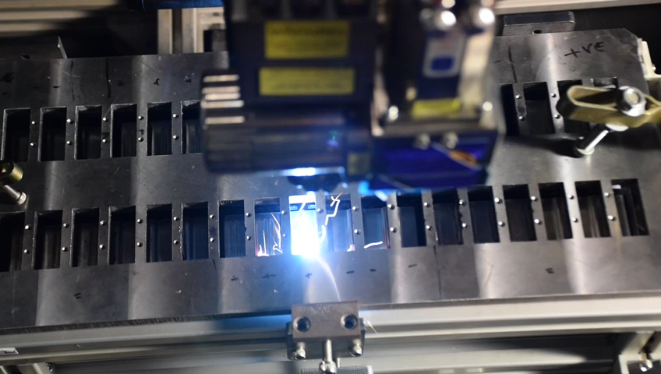
Battery welding

Slide 21


Slide 22
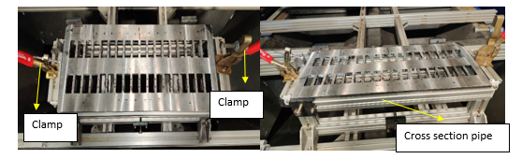
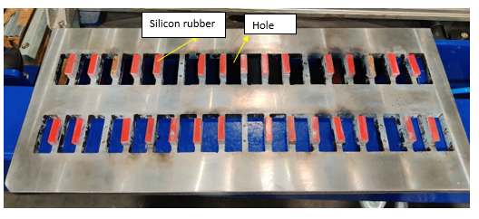
BATTERY FIXTURE

Slide 23
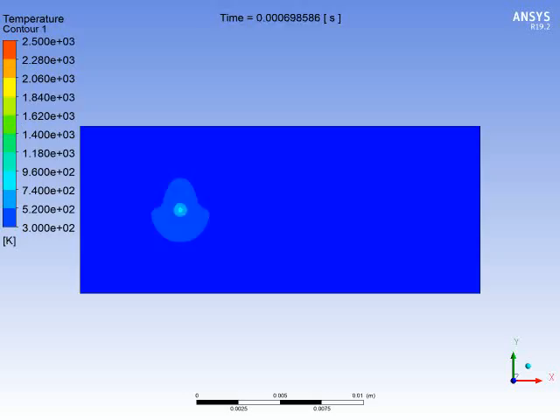
ANSYS SIMULATION FOR LINEAR LASER WELDING.
This is a simulation done in ANSYS software and shows the motion of heating of material before it melts
Time moves from 0 to 0.35 sec and temperature distribution shows the heat-affected zone.

Slide 24
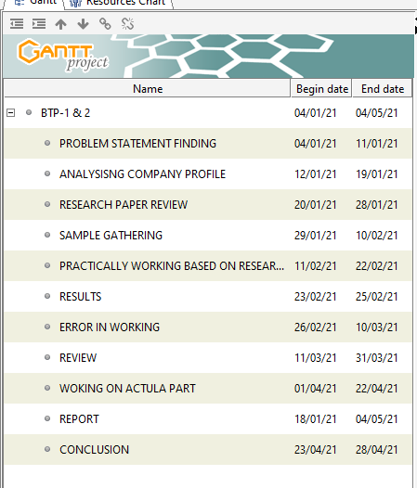
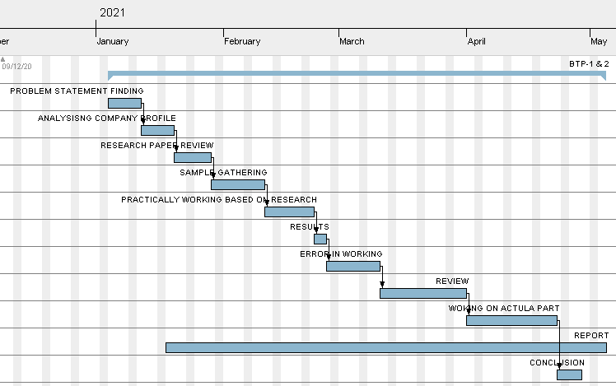
GANTT CHART

Slide 25
LEARNING IN INDUSTRY
Software skills
Solid Edge, HRMS, 2-D AutoCAD, Solid Works, ERP of SLTL.
Technical skills
Operating training in laser welding machine
Fixture mounting and many more.

Slide 26
PROS AND CONS FOR LASER WELDING
PROS
Less time consuming.
Higher accuracy can be achieved.
Can be used for mass production in larger industry.
CONS
Costly operation.
Requires a pre-knowledge/training before working on machine.

Slide 27
CONCLUSION
The review of results on laser welding of AL-6063 to AL-6063 on lithium-ion battery as a lap or spot weld are presented and discussed in this paper. There were some welding defects, such as bubble burst, hole, linear pattern of weld bend and calibrated of machine setup which is especially important for industrial applications are observed and then all these defects are reduced to a certain level of acceptance.
The laser beam was de-focused at 255 mm from the real Z-axis value. The laser had a power of 1600 Watts and an 85 percent duty cycle. The welded bend had a thickness of less than 3 mm (nearly 2.6mm) and measured 36 mm length of weld. The speed was maintained at 1100 (mm/min). After selection of perfect parameters for laser weld we try that with lithium-ion battery and try to reduce defects in that too.
We can get a deeper penetration in the material used to lap weld with higher welding strength, but surface voids and spatter are reduced. The estimated results are in good agreement with the measured data, indicating that the established model can adequately predict the responses within the limits of welding parameters used, according to the validation experiments.

Slide 28
FUTURE SCOPE
Macro Structure Examination Of Material.
Vibration Test After Welding.
Techniques Reduced Reflection While Welding.
Universal Testing Machine (UTM) Of Welded Part In Material.

Slide 29
APPENDIX -I
References
Bappa Acherjee, DiptenMisra, DipankarBose, K.Venkadeshwaran 2009 “Prediction of weld strength and seam width for laser transmission welding of thermoplastic using response surface methodology” doi:10.1016/j.optlastec.2009.04.007
M Nagy and M Behúlová 2017 “Design of welding parameters for laser welding of thin-walled stainless steel tubes using numerical simulation” doi:10.1088/1757-899X/266/1/012013
L. Zhou Z.Y. Li , X.G. Song, C.W. Tan , Z.Z. He , Y.X. Huang , J.C. Feng 2017 “Influence of laser offset on laser welding-brazing of Al/brass dissimilar alloys” http://www.elsevier.com/locate/jalcom
Gantt chart software (open source)
SLTL website (https://www.sltl.com/)

Slide 30
Thank You
☺☺☺
SPECIAL THANKS TO
Mr. Mayank patel
Mr. Purv patel
Mr. Vailbhav gajera
Professor Shashi paraksh

